Slide 1
Transact – Data Migration

Slide 2






Activities and Deliverables
Data Migration
Recommended Activities
Deliverables
Identification of Data sources, and data sets to be migrated
Finalize migration scope Estimate migration data sets volumes (number of records to be migrated)
Develop approach for static data, inflight transactions
Develop high level cutover approach
Define Migration acceptance and sign-off criteria
DM Strategy
Strategy
Analysis of source systems for data mapping to Target System
Reports analysis and profiling (source & target) – any additional data requirements
Data exception report
Identify audit & reconciliation requirements
Document data migration requirements (business & technology)
Mapped DMS (Data Mapping Sheets)
Analysis
Data elements are mapped from source to target
Plan for freezing physical data structures during the migration is put together.
Migration tools identified & any local customizations done
Run T24 Data upload (Temenos DM tool) Reconciliation / data checking reports are run.
Acceptance criteria and performance metrics are evaluated.
DM Tool Configurations(for configuration & scripts)
Scripts for loading
Scripts for technical reconciliations
Updated Migration Runbook
Mapping,
Transformation and Load
Data elements are mapped from source to target
Plan for freezing physical data structures during the migration is put together.
Migration tools identified & any local customizations done
Run T24 Data upload (Temenos DM tool) Reconciliation / data checking reports are run.
Acceptance criteria and performance metrics are evaluated.
Mock Run
Refined migration Runbook
Refined cut-over plan
Trial Runs & Dress Rehearsals
Cut-Over
Go Live Preparation
Cutover Plan Execution
Migrate Production
Migrated data to Production

Slide 3








Data Migration Framework (Legacy System to Temenos)
PROGRAM GOVERANCE
PROCESS FLOW
Data will be Extracted and provided from source system by the Bank
Establish a network link and securely transfer the data to our data Landing Layer / Staging Layer.
Store the incoming data and load it into Stagging data format.
Transform and map the data onto the Temenos agreed data model format.
Identify errors and discrepancies across all data ready for delivery. (Iterative ongoing process)
Deliver the migrated data to Bank for Functional reconciliation and Signoff .
Onsite/Offshore Model
Onsite/Offshore Model
Requirements
Requirements
Iterative Process
7
Data Sources
Landing Layer
Stagging Layer
Transformation Layer
Target System
Legacy
2
Profile & Understand
Transform
DM Tool
External
Data
Sources 1
4
6
Temenos System
Source 1
Secured
Data
Transfer
Stagging
Data Format
Discover, model, and govern information structure and content
Combine and restructure information for T24
1
Deliver
Validation & Standardize
Agreed Data Format
Source 2
External
Data
Sources 2
3
5
Source 3
Standardize, and correct information
Iterative Process
Reconciliation Layer / Report Generation

Slide 4
Introduction to Cutover Process
Closing the bank business on last working day in Client System
The opening of bank business in Transact, on the following working day
Data Migration
(Cutover Weekend)
Client System
Transact System
Agreed time window on Cutover Weekend

Slide 5

Training Agenda
Data Mapping Sheet
Migration Rules
Pre-requisite
Data Mapping Definition
Data File Preparation
Validation/Loading Process
Exception Handling
Reporting

Slide 6
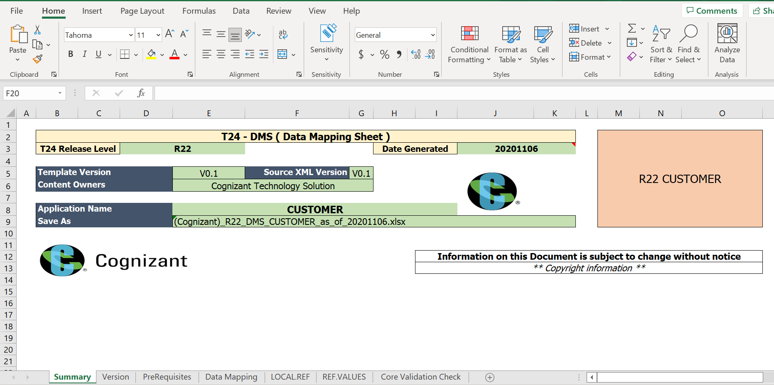
Data Mapping Sheet
A DMS should contain complete details on all fields of an application that can be inputted.
It also has the provision for mapping information from the client system.
The worksheets of the DMS are
Summary
Version
Prerequisite
Data Mapping
LOCAL.REF
REF.VALUES
Core Validation Check

Slide 7
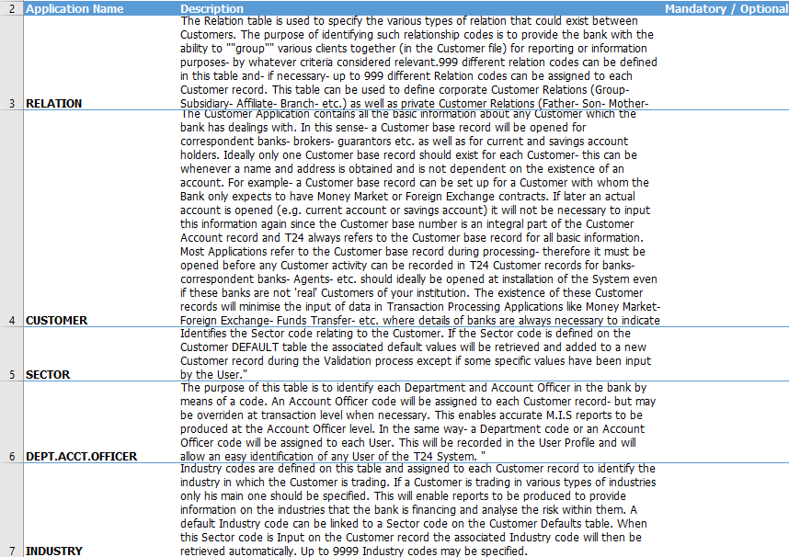
Data Mapping Sheet - 3
Prerequisite
To upload records to this application, you must have the pre-requisite tables.

Slide 8
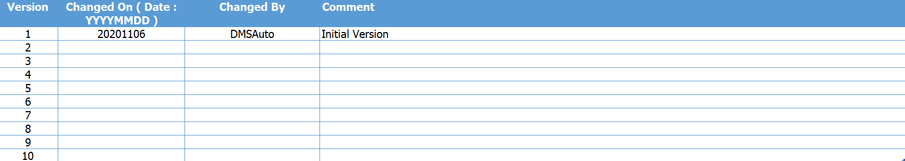
Data Mapping Sheet - 2
Summary
T24 Release Level, Date Generated and Application Name are captured.
Version
It explains the Creation of DMS and the history of changes.
Comments to be added for each version updates.

Slide 9
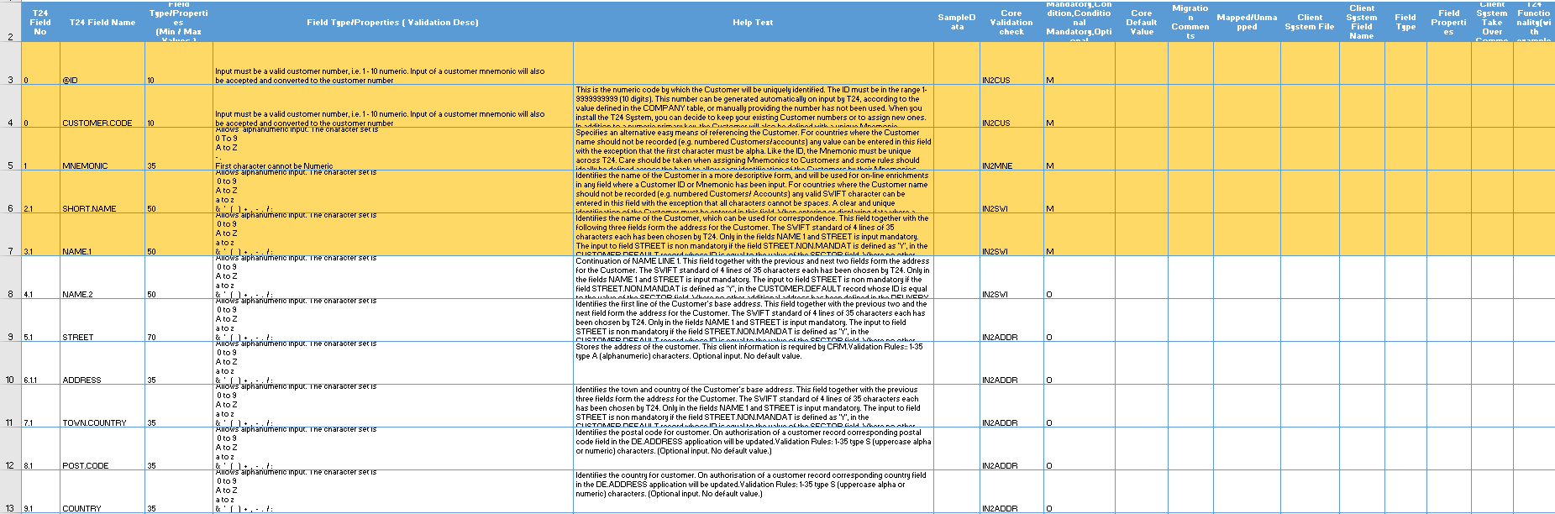
Data Mapping Sheet - 3
Data Mapping
It explains the T24 Field No, T24 Field Name, Field Type/Properties, HelpText, Sample Data, Core Validation check, Mandatory, Condition, Conditional Mandatory, Optional (M,C,C/M,O), Core Default Value, Migration Comments, Client System File, Client System Field Name, Field Type, Field Properties, Client System Take Over Comment, Mapped/Unmapped, T24 Functionality(with example) and Business scenarios with example.

Slide 10
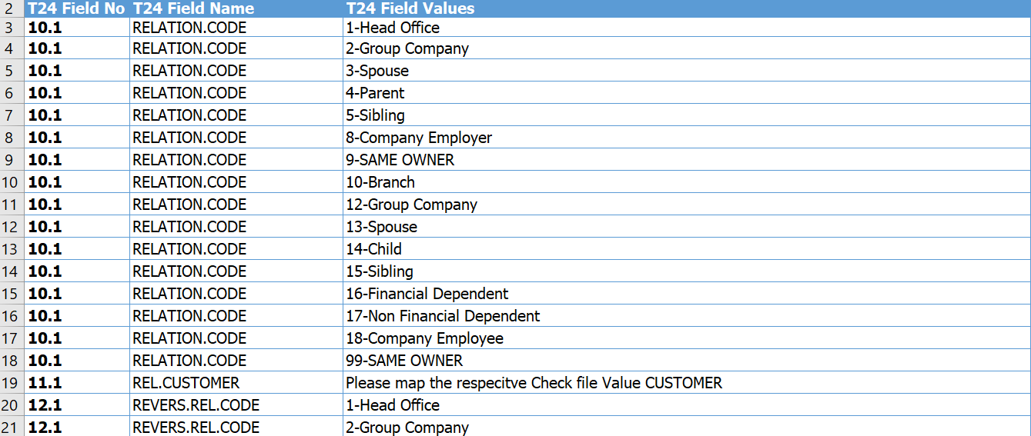
Data Mapping Sheet - 4
REF.VALUES
It explains in detail the vetting table and look up table values which are available in each fields of the Application.

Slide 11
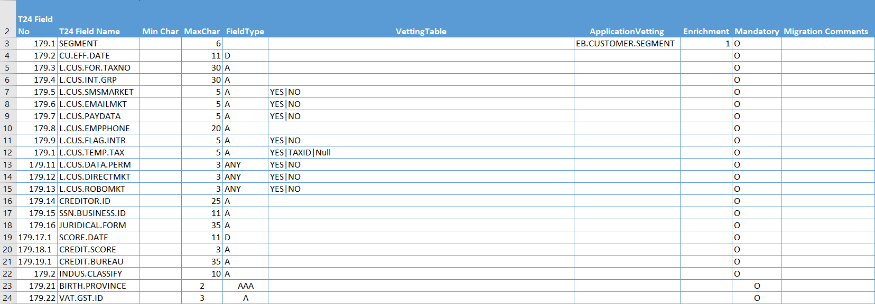
Data Mapping Sheet - 5
LOCAL.REF
Local Field number, Local Field name, field types and properties are captured.

Slide 12
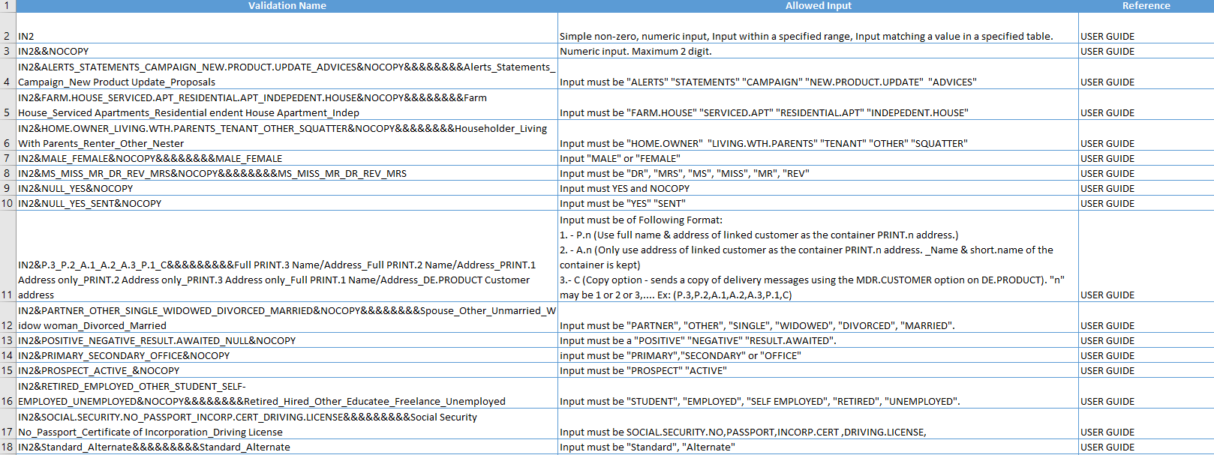
Data Mapping Sheet - 6
Core Validation Check
It explains in detail about the Core Validation types and the allowed inputs for each validation type.

Slide 13
Migration Prerequisites
All the T24 parameter tables should be setup prior to the migration.
Even if the Client System doesn't have any relevant data for a mandatory field, value must be passed.
Historical data and closed contracts are not migrated.
Data file would be validated until no errors and then loaded with zero level authorization.
There shouldn't be any dependencies between the data records in the same data file.
A maximum of 100000 records are allowed to pass in a single data file and multiple data files can be provided accordingly.
The data from the client system may be in a format which is unacceptable in the Transact. Such data needs cleansing and conversion/translation in a format acceptable in Transact.
The data file can be loaded in single/multi-thread mode.

Slide 14
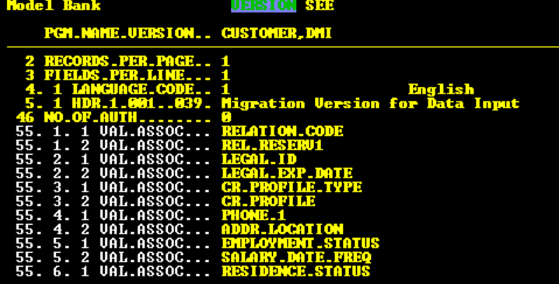
Pre-requisite
DM Tool components
DM Tool to be deployed in the Transact environment.
Ensure all the components released as part of tool are authorized successfully.
The Validation and Input VERSIONS need to be created separately.
Validation version to be created for each application as APPLICATION.NAME,DMV and Input Version to be created as APPLICATION.NAME,DMI

Slide 15
Data Mapping Definition - 1
This is the base mapping definition table, which maps the incoming data with T24 fields. The following items are defined here.
T24 Table to be Loaded
Type of Load to be done (Example – OFS, Read Replacement or Write)
Type of Action to be performed (Example – Only Validate the data or actual load)
Function to be used (Allowed function are Input, Authorize, Delete, Reverse).
If not mentioned, Input function will be used by default.
Way to identify each field in a transaction/record (Example – by delimiter or position)
Associated multi-valued sets to map the T24 field with Data, by giving the position or delimiter to identify the data from the source file.
Any Post Update routine that will be called for every transaction/record being loaded.

Slide 16
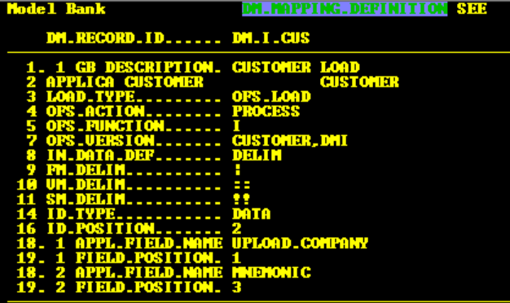
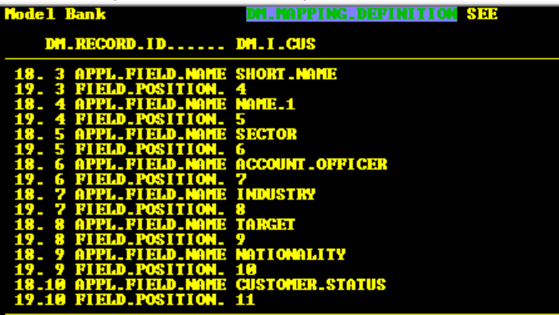
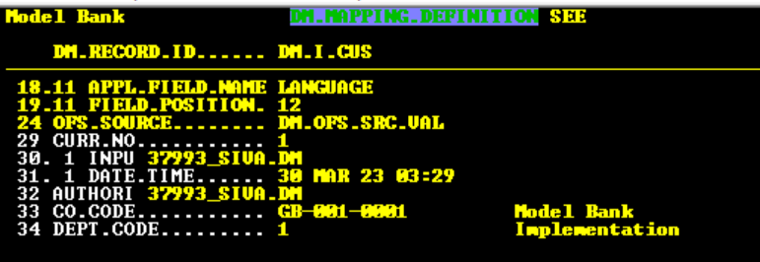
Data Mapping Definition - 2
This application allows the user to define the format of the data in the incoming data file
Separate DMDs each for Validation and Input should be created.
DM.OFS.SRC.VAL would be OFS.SOURCE record used in the DMD.

Slide 17
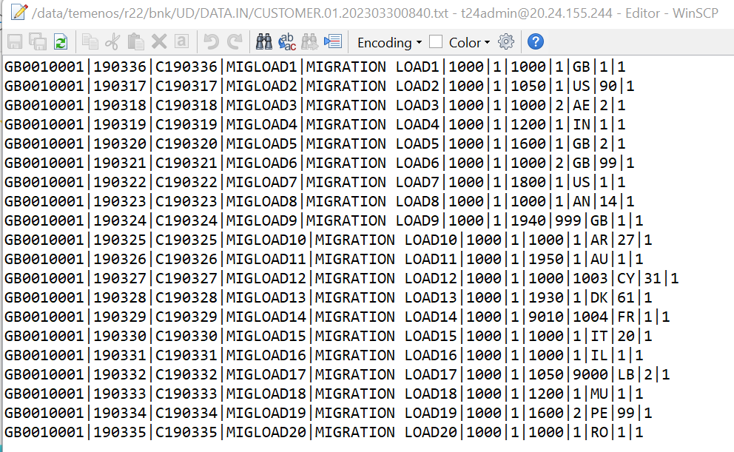
Data File Preparation - 1
Prepare the data file in a specific format as per the DMS
Each field will be separated by a delimiter ( “ | “ )
< Field.1>|< Field.2>|< Field.3>
For the multi-value fields, we use “::” as delimiter
< Field.1>|< Field.2.1>::< Field.2.2>::< Field.2.3>|< Field.3>
For the sub-value fields, we use “!!” as delimiter
< Field.1>|< Field.2.1.1>!! < Field.2.1.2>::< Field.2.2>|< Field.3>

Slide 18
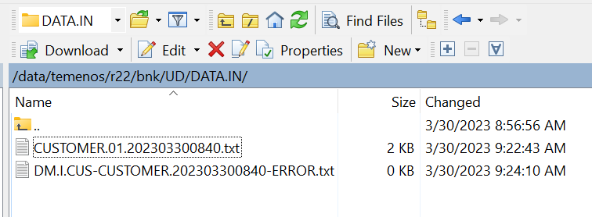
Data File Preparation - 2
Input values for all the mandatory fields in the data file and optional fields may or may not have values in the data file.
Before the load process initiated, check whether the directory DATA.IN is existing in UD directory,
if not create the directory DATA.IN by using the following command in DBTools.
CREATE.FILE DATA DATA.IN TYPE=UD
Place the data file in DATA.IN folder with the correct naming convention
<LOAD.NAME>.01.<YYYYMMDDHHMMSS>.txt

Slide 19
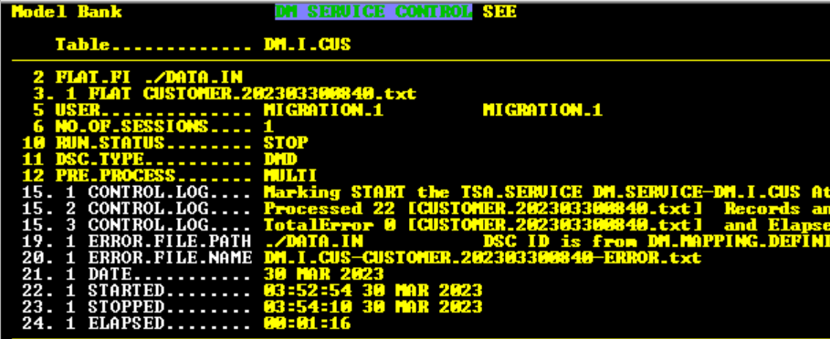
Validation/Loading Process – DM.SERVICE.CONTROL
DSC (DM.SERVICE.CONTROL) is used to control the actual load process.
The record id for DSC will be same as the DMD id
Load Company – The Company for which the data is loaded. If this information is not provided in the incoming tape, it must be provided here.
Data file directory and file name – A valid directory name and file name.
Number of Sessions – The number of sessions with which the TSA.SERVICE must be run.
Run Status – To Request for a STOP of the TSA.SERVICE.
User – The username which will be used for the Load process. This username will get updated in the TSA.SERVICE record related to the DM.SERVICE.CONTROL. Initially DMUSER was hardcoded as the USER.
RUN.STATUS – Implies whether the status of service as START or STOP.
DSC.TYPE – Implies whether the service is for DMD(Loading) or DME(Extraction)
Error Details, No Of Error and Type Of Error – The details of the errors that are generated during validation/process will be updated in these fields. Date, Started, Stopped and Elapsed – The Current system Date, the start time, end time and the elapsed time of validation/process activity will be updated in these fields.
.

Slide 20
Validation/Loading Process
Commit and verify the DSC record to start the validation/loading
Make sure there are no errors in the file by first validating it.
The file can be loaded after successful validation without errors.
The status of the services should be monitored to ensure no other services are in running status.
As soon as the DSC has been verified, the status of the service will be updated as START.
Ensure T24 Service Manager (TSM) is in running status which will initiate the T24 Service Agents (TSA) for the service to run.
Status of the service will be STOP after the service has been completed.
Check for errors in DSC and analyze the cause and correction action if there are errors as per the Error Handling procedure.
The timing log, issue log and activity log to be updated.

Slide 21
Workflow Diagram
Start
Create Version and DMD record
Place the files in the directory DATA.IN
Input and Verify DSC record to start the service
Service will be started automatically if the TSM is already running in the background. Otherwise, TSM to be started manually.
Any Error in log file ?
Yes – Fix the errors
No
End

Slide 22
Exception Handling
If any error occurs during loading (validation, input) due to incorrect data or DM Load configuration or T24 parameter setup, the file needs to be corrected and validated again until no errors occur.
The error will be logged in the DSC in the field Error Detail and the Number of Records in Error will be captured in the field NO.OF.ERROR and type of Error will be captured in the field TYPE.OF.ERROR.
In the case the error is still unknown, the OFS in and out messages can be obtained in OFS.REQUEST.DETAIL by changing DM.OFS.SRC.ORD in the OFS.SOURCE field.

Slide 23
Reporting
➢Issue Log
The Issue Log can be created manually in an Excel Sheet with the detailed information of the errors during the load process.

Slide 24
Reporting - 2
Timing Log
The Start Time, End Time, User and Inputter Name can be taken using this Enquiry.

Slide 25
Thank you…

